Slide 1
Unit 4 Database Normalization

Slide 2
RDBMS (relational database management system)
A relational database management system (RDBMS) is a collection of programs and capabilities that enable IT teams and others to create, update, administer and otherwise interact with a relational database.
RDBMS store data in the form of tables, with most commercial relational database management systems using Structured Query Language (SQL) to access the database.

Slide 3
Pitfalls in Relational DB Design
A bad design may have several properties, including:
Repetition of information.
Inability to represent certain information.
Loss of information.

Slide 4
Anomaly
Anomalies are the problems that can occur in poorly planned databases where all the data are stored in one table.
Anomalies are caused when there is too much redundancy in the database’s information.
There are 3 types of anomalies. They are:
Insert Anomaly
Delete Anomaly
Update Anomaly

Slide 5
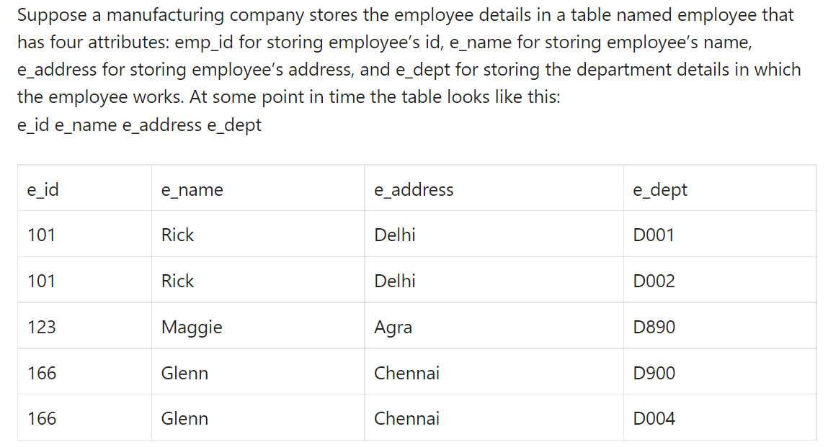
Example:

Slide 6
Insert anomaly:
Suppose a new employee joins the company, who is under training and currently not assigned to any department then we would not be able to insert the data into the table if the e_dept field doesn’t allow nulls.

Slide 7
Delete anomaly:
Suppose, if at a point of time the company closes the department D890 then deleting the rows that are having e_dept as D890 would also delete the information of employee Maggie since she is assigned only to this department.

Slide 8
Update anomaly:
In the above table, we have two rows for employee Rick as he belongs to two departments of the company. If we want to update the address of Rick then we have to update the same in two rows or the data will become inconsistent.
If somehow, the correct address gets updated in one department but not in other then as per the database, Rick would be having two different addresses, which is not correct and would lead to inconsistent data.

Slide 9
Question:
What is RDBMS? What are the pitfalls in Relational DB Design?
What is Anomaly? What are the types? Explain.

Slide 10
Informal Design Guidelines for Relational Schemas
Informal Design guidelines that may be used as measures to determine the quality of relation schema design are:
Making sure that the semantics of the attributes is clear in the schema
Reducing the redundant information in tuples
Reducing the NULL values in tuples
Disallowing the possibility of generating spurious tuples

Slide 11
1. Making sure that the semantics of the attributes is clear in the schema
Whenever we are going to form relational schema there should be some meaning among the attributes. This meaning is called semantics. This semantics relates one attribute to another with some relation.
Guideline 1::Informally, each tuple in a relation should represent one entity or relationship instance.
Attributes of different entities should not be mixed in the same relation.
Only foreign keys should be used to refer to other entities.
Entity and relationship attributes should be kept apart as much as possible.

Slide 12
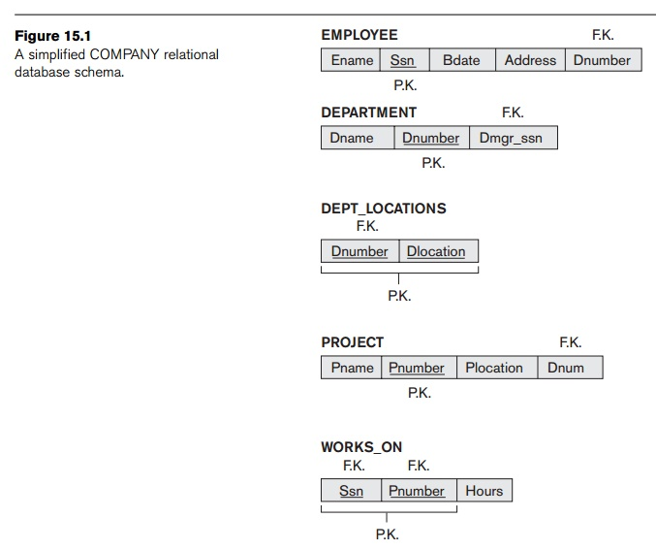
Guideline 1 example

Slide 13
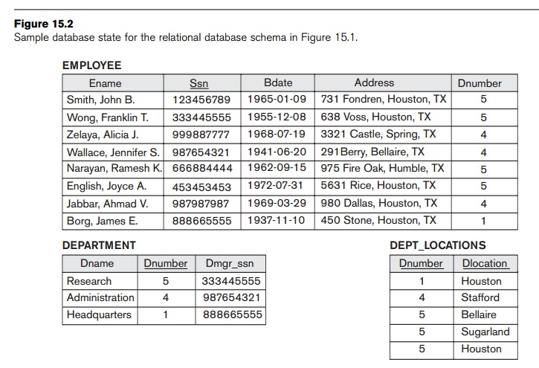
Guideline 1 example

Slide 14
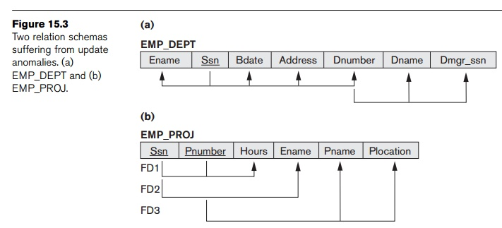
Guideline 1 Example

Slide 15
Reducing the redundant information in tuples and anomalies
One goal of schema design is to minimize the storage space used by the base relations (and hence the corresponding files). Grouping attributes into relation schemas has a significant effect on storage space.
For example, compare the space used by the two base relations EMPLOYEE and DEPARTMENT in Figure 15.2 with that for an EMP_DEPT base relation in Figure 15.4, which is the result of applying the NATURAL JOIN operation to EMPLOYEE and DEPARTMENT. In EMP_DEPT, the attribute values pertaining to a particular department (Dnumber, Dname, Dmgr_ssn) are repeated for every employee who works for that department. In contrast, each department’s information appears only once in the DEPARTMENT relation in Figure 15.2. Only the department number (Dnumber) is repeated in the EMPLOYEE relation for each employee who works in that department as a foreign key. Similar com-ments apply to the EMP_PROJ relation (see Figure 15.4), which augments the WORKS_ON relation with additional attributes from EMPLOYEE and PROJECT.

Slide 16
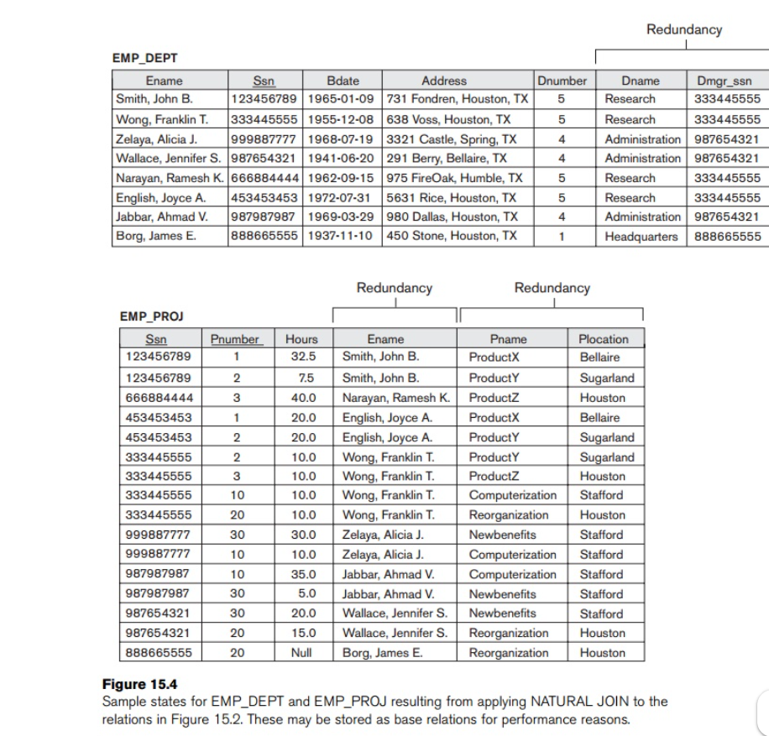

Slide 17
Reducing the redundant information in tuples and anomalies
Guideline 2
Design the base relation schemas so that no insertion, deletion, or modification anomalies are present in the relations. If any anomalies are present, note them clearly and make sure that the programs that update the database will operate correctly.
Types of anomalies are explain in above slides

Slide 18
Reducing the NULL values in tuples
In some schema designs we may group many attributes together into a “fat” relation. If many of the attributes do not apply to all tuples in the relation, we end up with many NULLs in those tuples. This can waste space at the storage level and may also lead to problems with understanding the meaning of the attributes and with specifying JOIN operations at the logical level. Another problem with NULLs is how to account for them when aggregate operations such as COUNT or SUM are applied.

Slide 19
Reducing the NULL values in tuples
Guideline 3
As far as possible, avoid placing attributes in a base relation whose values may frequently be NULL. If NULLs are unavoidable, make sure that they apply in exceptional cases only and do not apply to a majority of tuples in the relation.
Using space efficiently and avoiding joins with NULL values are the two overriding criteria that determine whether to include the columns that may have NULLs in a relation or to have a separate relation for those columns (with the appropriate key columns). For example, if only 15 percent of employees have individual offices, there is little justification for including an attribute Office_number in the EMPLOYEE relation; rather, a relation EMP_OFFICES(Essn, Office_number) can be created to include tuples for only the employees with individual offices.

Slide 20
Disallowing the possibility of generating spurious tuples
Spurious tuples are extra generated false record occurred during natural join operation of relations on basis of foreign key with not primary attribute of another relation.

Slide 21
Disallowing the possibility of generating spurious tuples
Consider the two relation schemas EMP_LOCS and EMP_PROJ1 in Figure 15.5(a), which can be used instead of the single EMP_PROJ relation in Figure 15.3(b). A tuple in EMP_LOCS means that the employee whose name is Ename works on some project whose location is Plocation. A tuple in EMP_PROJ1 refers to the fact that the employee whose Social Security number is Ssn works Hours per week on the project whose name, number, and location are Pname, Pnumber, and Plocation. Figure 15.5(b) shows relation states of EMP_LOCS and EMP_PROJ1 corresponding to the

Slide 22
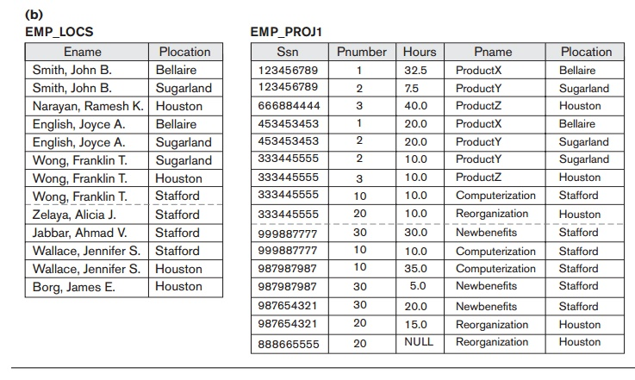
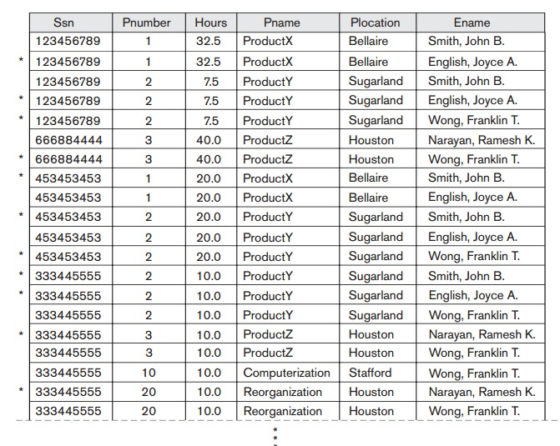
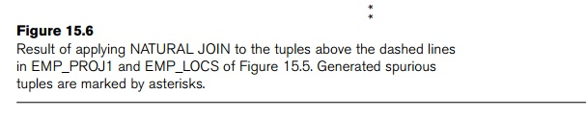
example

Slide 23
example
Decomposing EMP_PROJ into EMP_LOCS and EMP_PROJ1 is undesirable because when we JOIN them back using NATURAL JOIN, we do not get the correct original information. This is because in this case Plocation is the attribute that relates EMP_LOCS and EMP_PROJ1, and Plocation is neither a primary key nor a foreign key in either EMP_LOCS or EMP_PROJ1. We can now informally state another design guideline.

Slide 24
Disallowing the possibility of generating spurious tuples
Guideline 4
Design relation schemas so that they can be joined with equality conditions on attributes that are appropriately related (primary key, foreign key) pairs in a way that guarantees that no spurious tuples are generated. Avoid relations that contain matching attributes that are not (foreign key, primary key) combinations because joining on such attributes may produce spurious tuples.

Slide 25
Functional Dependency
Functional Dependency (FD) is a constraint that determines the relation of one attribute to another attribute in a Database Management System (DBMS). Functional Dependency helps to maintain the quality of data in the database. It plays a vital role to find the difference between good and bad database design.
A functional dependency is denoted by an arrow “→”. The functional dependency of X on Y is represented by X → Y.
X -> Y holds if whenever two tuples have the same value for X, they must have the same value for Y
For any two tuples t1 and t2 in any relation instance r(R): If t1[X]=t2[X], then t1[Y]=t2[Y]
Let’s understand Functional Dependency in DBMS with example.

Slide 26
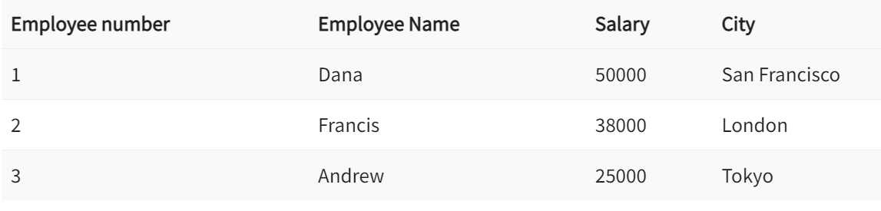
Example:
In this example, if we know the value of Employee number, we can obtain Employee Name, city, salary, etc. By this, we can say that the city, Employee Name, and salary are functionally depended on Employee number.

Slide 27
Types of Functional Dependency
Functional Dependency has two forms −
Trivial Functional Dependency
Non-Trivial Functional Dependency
Fully Functional dependency
Partial functional dependency
Transitive dependency
Multivalued dependency

Slide 28
Trivial Functional Dependency
It occurs when B is a subset of A in −
A ->B
Example
We are considering the <Department> table with two attributes to understand the concept of trivial dependency.
The following is a trivial functional dependency since DeptId is a subset of DeptId and DeptName
{ DeptId, DeptName } -> Dept Id

Slide 29
Non –Trivial Functional Dependency
It occurs when B is not a subset of A in −
A ->B
Example
DeptId -> DeptName
The above is a non-trivial functional dependency since DeptName is a not a subset of DeptId.

Slide 30
Full Dependency
An attribute is fully functional dependent on another attribute, if it is Functionally Dependent on that attribute and not on any of its proper subset.
an attribute Q is fully functional dependent on another attribute P, if it is Functionally Dependent on P and not on any of the proper subset of P.
Example: If we have a table Enrollment(StudentID, CourseID, Grade), the dependency (StudentID, CourseID) → Grade is a full functional dependency because neither StudentID nor CourseID alone can determine the Grade.

Slide 31
Partial Dependency
The FD (functional dependency) A->B happens to be a partial dependency if B is functionally dependent on A, and also B can be determined by any other proper subset of A. For instance, we have a relationship like MO->N, M->P, and P->N. In this case, M is alone capable of determining N. It means that N is dependent partially on MO.
Student_ID | Course_ID | Course_Name | Instructor
1 | 101 | Math | Mr. Smith
1 | 102 | Science | Ms. Johnson
2 | 101 | Math | Mr. Smith
3 | 103 | English | Mr. Brown

Slide 32
Partial Dependency
Student_ID | Course_ID | Course_Name | Instructor
1 | 101 | Math | Mr. Smith
1 | 102 | Science | Ms. Johnson
2 | 101 | Math | Mr. Smith
3 | 103 | English | Mr. Brown
Explanation:
Candidate Key: {Student_ID, Course_ID}
Non-Prime Attribute: Course_Name, Instructor
Partial Dependency: Course_Name → Course_ID (since Course_Name depends on part of the primary key, which is Course_ID)ss

Slide 33
Transitive Dependency
Consider two functional dependencies A → B and B → C then according to the transitivity axiom A → C must also exist. This is called a transitive functional dependency.
In other words, dependent is indirectly dependent on determinant in Transitive functional dependency.
Employee_Id | Name | Department | Street Number
1 | Zayn | CD | 11
2 | Phobe | AB | 24
3 | Hikki | CD | 11
4 | David | PQ | 71
5 | Phobe | LM | 21
Here, { Employee_Id → Department } and { Department → Street Number } holds true. Hence, according to the axiom of transitivity, { Employee_Id → Street Number } is a valid functional dependency.

Slide 34
Multivalued functional dependency
In Multivalued functional dependency, attributes in the dependent set are not dependent on each other.
For example, X → { Y, Z }, if there exists is no functional dependency between Y and Z, then it is called as Multivalued functional dependency.
Employee_Id | Name | Age
1 | Zayn | 24
2 | Phobe | 34
3 | Hikki | 26
4 | David | 29
4 | Phobe | 24
Here, { Employee_Id } → { Name, Age } is a Multivalued functional dependency, since the dependent attributes Name, Age are not functionally dependent(i.e. Name → Age or Age → Name doesn’t exist !).

Slide 35
Armstrong’s Axioms Property of Functional Dependency
Armstrong’s Axioms property was developed by William Armstrong in 1974 to reason about functional dependencies.
The property suggests rules that hold true if the following are satisfied:
Transitivity If A->B and B->C, then A->C i.e. a transitive relation.
Reflexivity A-> B, if B is a subset of A.
Augmentation The last rule suggests: AC->BC, if A->B
Other Inference rules are:
Decomposition:
If X -> YZ, then X -> Y and X -> Z
Union:
If X -> Y and X -> Z, then X -> YZ

Slide 36
Closure set of functional dependency
The Closure Of Functional Dependency means the complete set of all possible attributes that can be functionally derived from given functional dependency using the inference rules known as Armstrong's Rules.
If “F” is a functional dependency then closure of functional dependency can be denoted using “{F}⁺”.

Slide 37
Example:
Consider a relation R={X,Y,Z,H,D}
Having functional dependencies as:
FD= X→YZ , DX→H, Y→H
Soln:
X→YZ Using Decomposition we can write X→Y, X→Z.
X→Y, Y→H Using Transitivity rule we can write X→H.
X→Y, X→Z, X→H Using Union we can write X→YH, X→ZH, X→YZH
So,
Closure of functional dependency is:
{F}⁺ ={X→YZ , DX→H, Y→H, X→Y, X→Z, X→H, X→YH, X→ZH, X→YZH…}

Slide 38
Closure set of attribute
Closure of an attribute X is the set of all attributes that are functionally determined by X.
It is denoted by X⁺ which means what X can determine.
Consider a relation R={X, Y, Z, H, D}
Having functional dependencies as:
FD= X→YZ , DX→H, Y→H
Soln:
Y⁺ = { Y, H}
X⁺ = { X, Y, Z, H}
DX⁺ = {D, X, Y, Z, H}

Slide 39
Decomposition
Decomposition is the process of breaking down in parts or elements. It replaces a relation with a collection of smaller relations. It breaks the table into multiple tables in a database.
Properties of Relational Decomposition:
Lossless Decomposition
Dependency Preservation
Lack of Data Redundancy

Slide 40
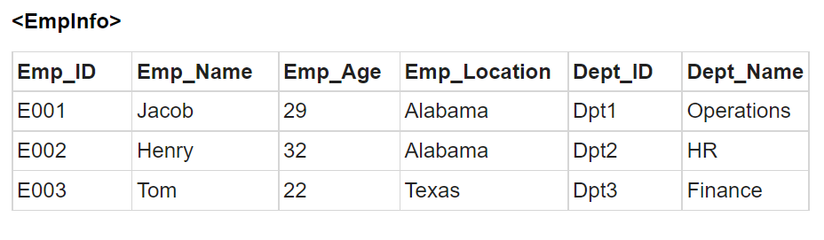
Lossy Decomposition
As the name suggests, when a relation is decomposed into two or more relational schemas, the loss of information is unavoidable when the original relation is retrieved.
Let us see an example −

Slide 41
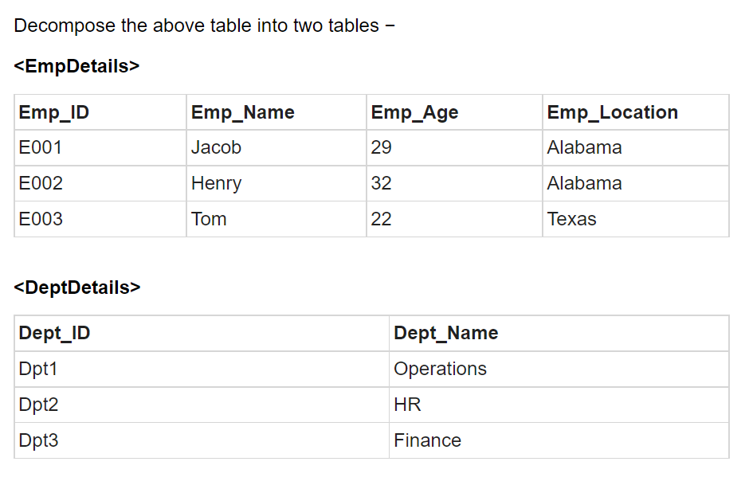
Now, you won’t be able to join the above tables, since Emp_ID isn’t part of the DeptDetails relation.
Therefore, the above relation has lossy decomposition.

Slide 42
1. Lossless Decomposition
Lossless-join decomposition is a process in which a relation is decomposed into two or more relations.
This property guarantees that the extra or less tuple generation problem does not occur and no information is lost from the original relation during the decomposition.
The decomposition is lossless when it satisfies the following statement −
If we union the sub Relation R1 and R2 then it must contain all the attributes that are available in the original relation R before decomposition.
Intersections of R1 and R2 cannot be Null. The sub relation must contain a common attribute. The common attribute must contain unique data.

Slide 43
Example:
Here,
R = (A, B, C)
R1 = (A, B)
R2 = (B, C)
The relation R has three attributes A, B, and C. The relation R is decomposed into two relation R1 and R2. . R1 and R2 both have 2-2 attributes. The common attributes are B.
The Value in Column B must be unique. if it contains a duplicate value then the Lossless-join decomposition is not possible.

Slide 44
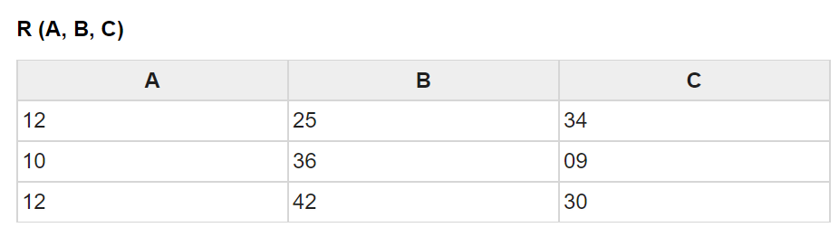
Example:
Draw a table of Relation R with Raw Data −

Slide 45
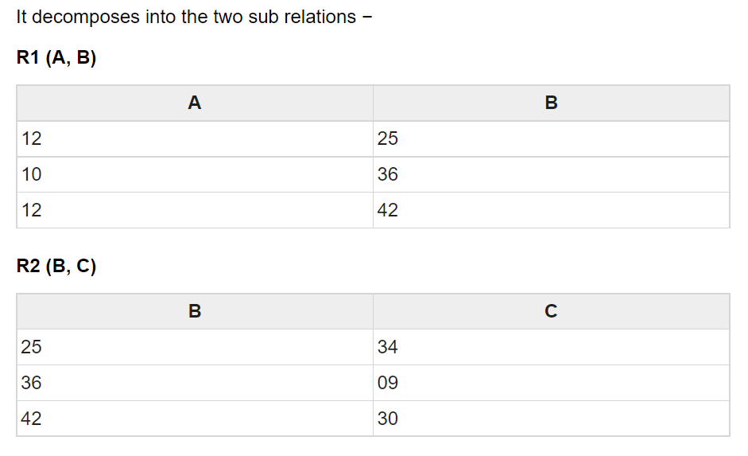
Example

Slide 46
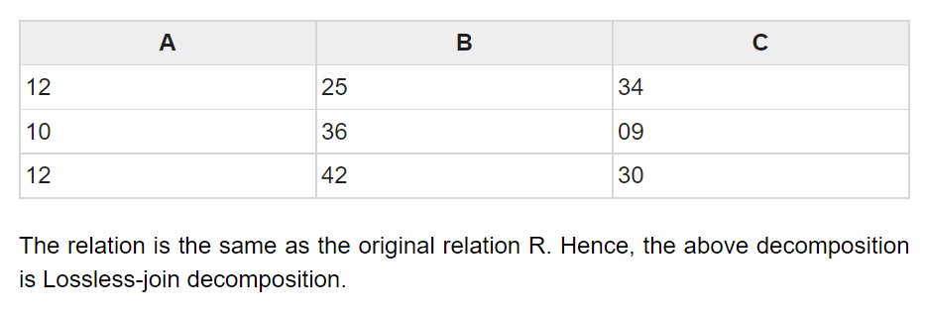
Example
Now, we can check the first condition for Lossless-join decomposition.
The union of sub relation R1 and R2 is the same as relation R.
R₁U R₂ = R
We get the following result −

Slide 47
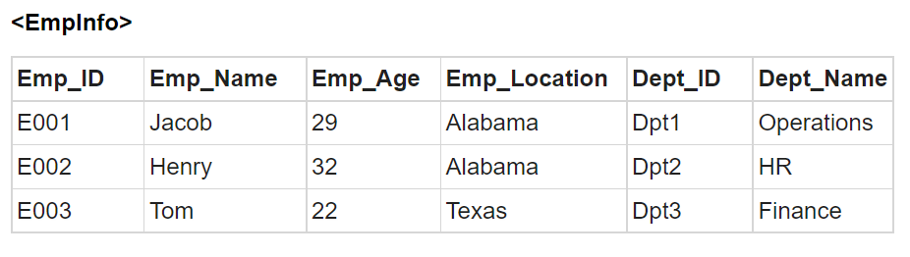
Example:
Let us see an example −

Slide 48
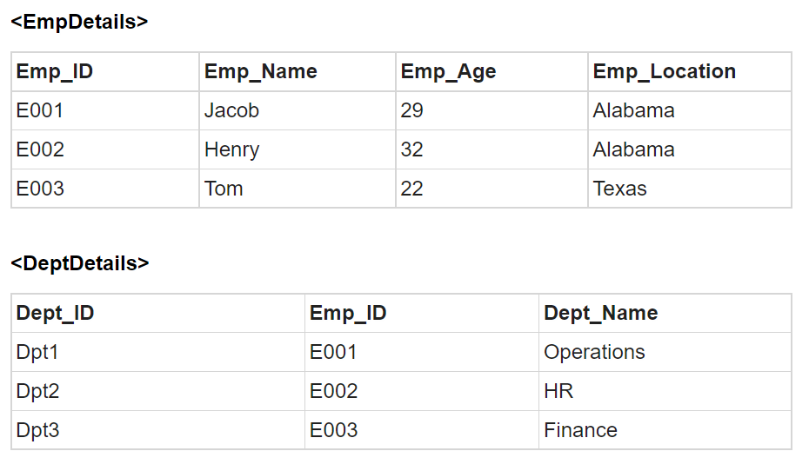
Example:
Decompose the above table into two tables:

Slide 49
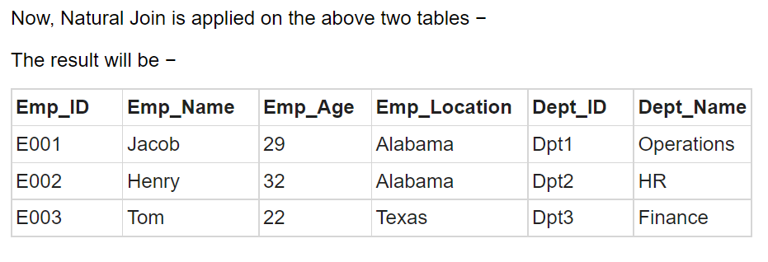
Example:
Therefore, the above relation had lossless decomposition i.e. no loss of information.

Slide 50
2.Dependency Preserving
It is an important constraint of the database.
In the dependency preservation, at least one decomposed table must satisfy every dependency.
If {A->B} holds, then two sets are functional dependent. And, it becomes more useful for checking the dependency easily if both sets in a same relation.
This decomposition property can only be done by maintaining the functional dependency
In this property, it allows to check the updates without computing the natural join of the database structure.

Slide 51
Example:
Suppose there is a relation R (A, B, C, D) with functional dependency set (A->BC). The relational R is decomposed into R1(ABC) and R2(AD) which is dependency preserving because FD A->BC is a part of relation R1(ABC).
Let us suppose, R is decomposed into:
R3(AB) and R4(ACD)
By using decomposition rule we can infer
A→B is FD of R3 and A→C is FD of R4
Then the dependency can be preserved by union of previous FD A→BC
Let us suppose, R is decomposed into:
R5(AB) and R6(CD)
Since we cannot infer A→BC using any inference rule hence dependency is not preserved.

Slide 52
3. Lack of Data Redundancy
Lack of Data Redundancy is also known as a Repetition of Information.
The proper decomposition should not suffer from any data redundancy
The careless decomposition may cause a problem with the data.
The lack of data redundancy property may be achieved by normalization process

Slide 53
Normalization:
Normalization is a database design technique that reduces data redundancy and eliminates undesirable characteristics like Insertion, Update and Deletion Anomalies.
Normalization rules divides larger tables into smaller tables and links them using relationships. The purpose of Normalization in SQL is to eliminate redundant (repetitive) data and ensure data is stored logically.
The inventor of the relational model Edgar Codd proposed the theory of normalization of data with the introduction of the First Normal Form, and he continued to extend theory with Second and Third Normal Form. Later he joined Raymond F. Boyce to develop the theory of Boyce-Codd Normal Form.

Slide 54
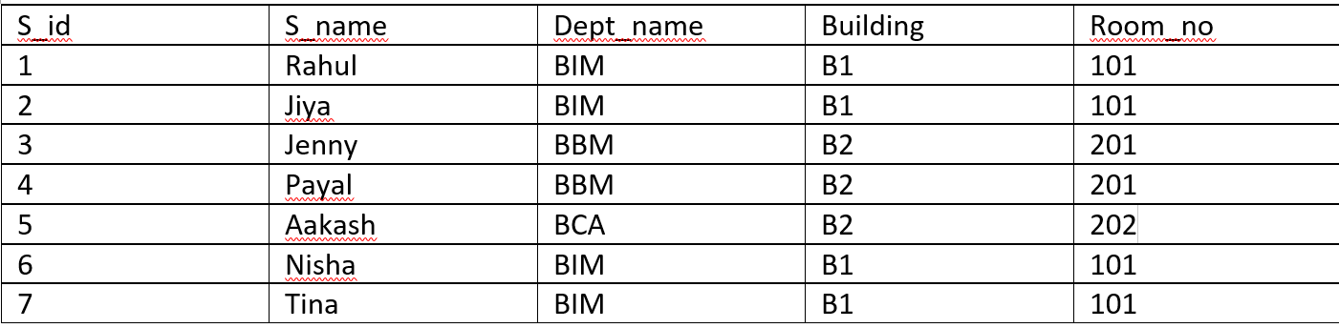
Example :
Suppose, we have student table which is given below. Now here the data is being redundant which can occur anomalies( insert, delete and update).

Slide 55
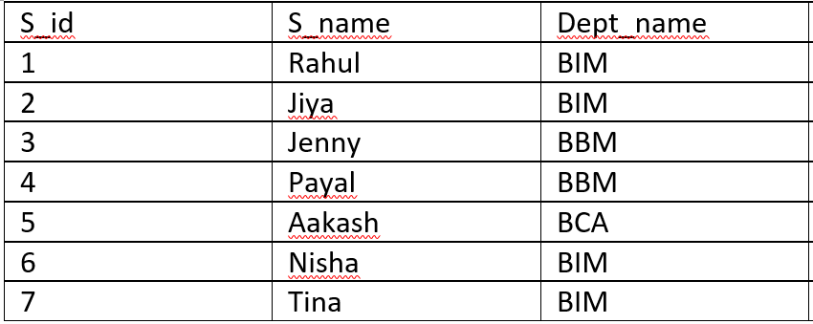
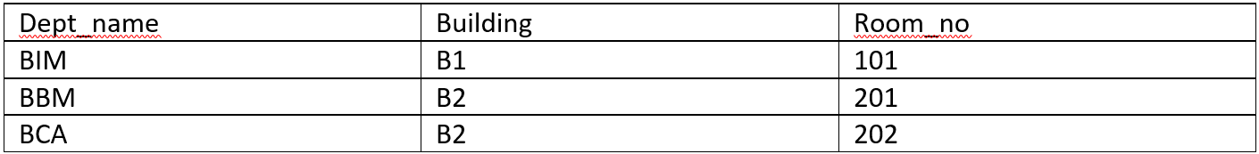
Example:
Student table
Solution
Normalizing table like this will reduce data redundancy and anomalies
Dept. table

Slide 56
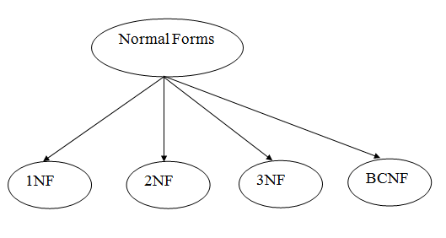
Database Normal Forms
Here is a list of Normal Forms in SQL:
1NF (First Normal Form)
2NF (Second Normal Form)
3NF (Third Normal Form)
BCNF (Boyce-Codd Normal Form)

Slide 57
First Normal Form (1NF):
If a relation contains a composite or multi-valued attribute, it violates the first normal form, or the relation is in first normal form if it does not contain any composite or multi-valued attribute. A relation is in first normal form if every attribute in that relation is singled valued attribute.
A table is in 1 NF if:
There are only Single Valued Attributes.
Attribute Domain does not change.
There is a unique name for every Attribute/Column.
The order in which data is stored does not matter.

Slide 58
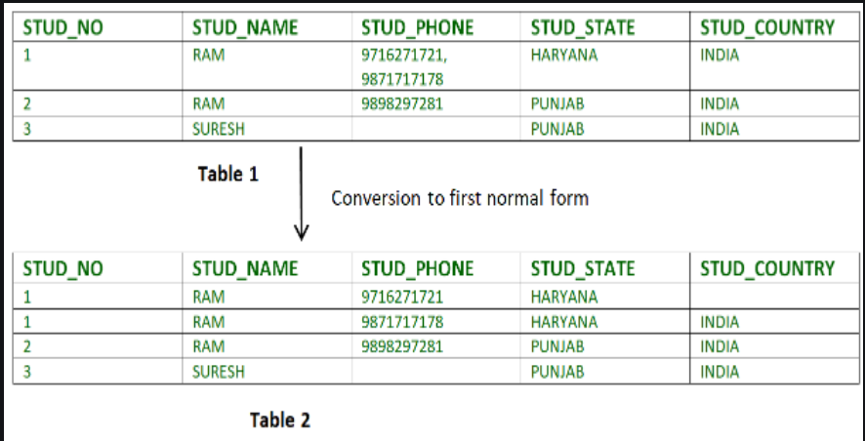
Example: Relation STUDENT in table 1 is not in 1NF because of multi-valued attribute STUD_PHONE. Its decomposition into 1NF has been shown in table 2.

Slide 59
First Normal Form (1NF) does not eliminate redundancy, but rather, it’s that it eliminates repeating groups.
Instead of having multiple columns of the same kind of data in a record, (0NF or Unnormalized form) you remove the repeated information into a separate relation and represent them as rows. This is what constitutes 1NF.

Slide 60
Second Normal Form (2NF):
Second Normal Form (2NF) is based on the concept of full functional dependency. Second Normal Form applies to relations with composite keys, that is, relations with a primary key composed of two or more attributes. A relation with a single-attribute primary key is automatically in at least 2NF. A relation that is not in 2NF may suffer from the update anomalies.
To be in second normal form, a relation must be in first normal form and relation must not contain any partial dependency. A relation is in 2NF if it has No Partial Dependency, i.e., no non-prime attribute (attributes which are not part of any candidate key) is dependent on any proper subset of any candidate key of the table.

Slide 61
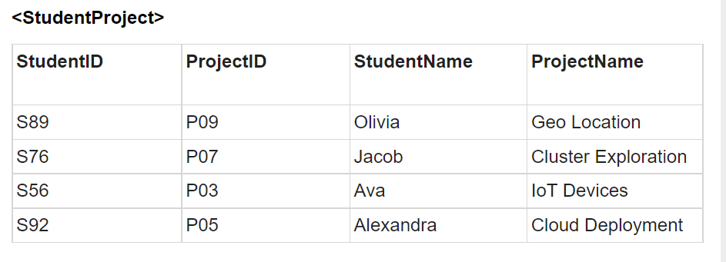
Example (Table violates 2NF)

Slide 62
Example:
In the above table, we have partial dependency; let us see how −
The prime key attributes are StudentID and ProjectID.
As stated, the non-prime attributes i.e. StudentName and ProjectName should be functionally dependent on part of a candidate key, to be Partial Dependent.
The StudentName can be determined by StudentID, which makes the relation Partial Dependent.
The ProjectName can be determined by ProjectID, which makes the relation Partial Dependent.
Therefore, the <StudentProject> relation violates the 2NF in Normalization and is considered a bad database design.

Slide 63

Example (Table converted to 2NF)
To remove Partial Dependency and violation on 2NF, decompose the above tables −
Now the relation is in 2nd Normal form of Database Normalization

Slide 64
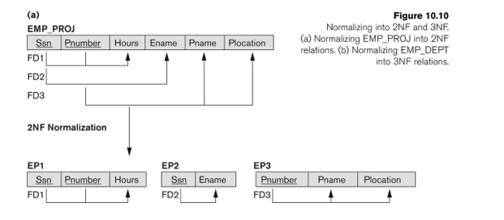
Another example:

Slide 65
Third Normal Form (3NF)
A relation will be in 3NF if it is in 2NF and does not contain any transitive dependency.
3NF is used to reduce the data duplication. It is also used to achieve the data integrity.
If there is no transitive dependency for non-prime attributes, then the relation must be in third normal form.

Slide 66
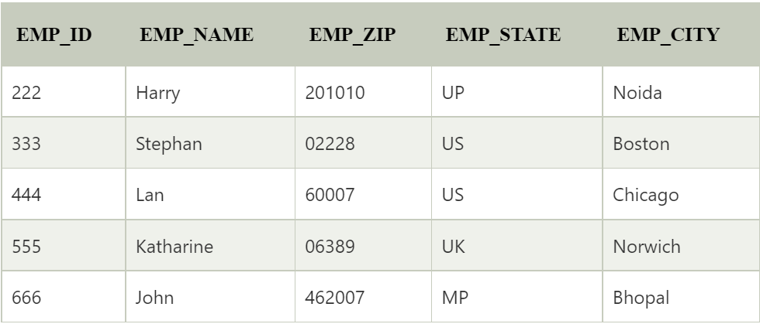
Example:
Suppose,
Emp_id is the primary key.
E_id→ Emp_name,Emp_Zip
Emp_zip →Emp_state, Emp_city
Here , Transitive dependency occurs.

Slide 67
Here, EMP_STATE & EMP_CITY dependent on EMP_ZIP and EMP_ZIP dependent on EMP_ID. The non-prime attributes (EMP_STATE, EMP_CITY) transitively dependent on super key(EMP_ID). It violates the rule of third normal form.
That's why we need to move the EMP_CITY and EMP_STATE to the new <EMPLOYEE_ZIP> table, with EMP_ZIP as a Primary key.

Slide 68
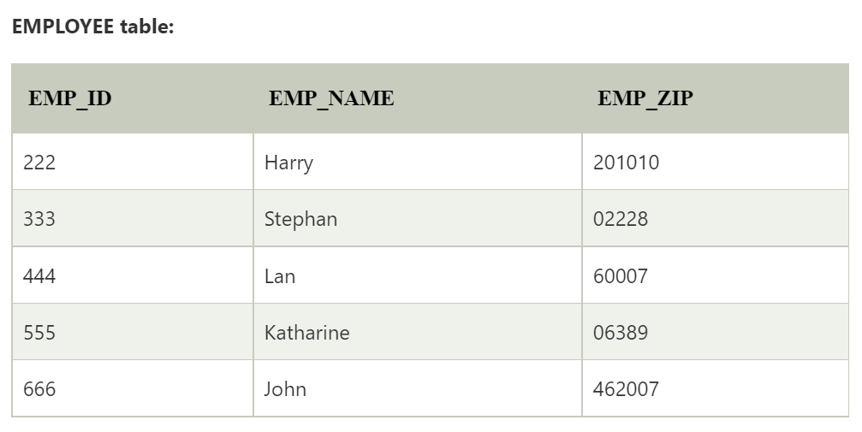

That's why we need to move the EMP_CITY and EMP_STATE to the new <EMPLOYEE_ZIP> table, with EMP_ZIP as a Primary key.

Slide 69
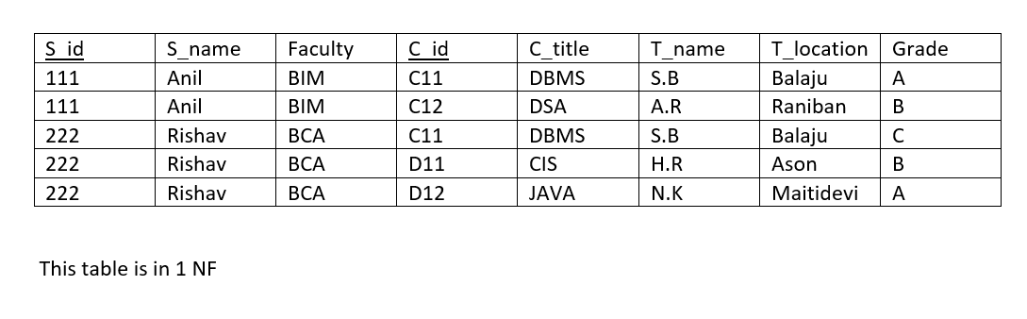
Question:
Normalize the table up to 3NF
Suppose ,
S_id→ S_name ,Faculty
C_id→C_title, T_name, T_location
S_id, C_id → Grade
T_name→ T_location

Slide 70
Boyce-Codd Normal Form (BCNF)
BCNF is the advance version of 3NF. It is stricter than 3NF.
A table is in BCNF if every functional dependency X → Y, X is the super key of the table.
For BCNF, the table should be in 3NF, and for every FD, LHS is super key.

Slide 71
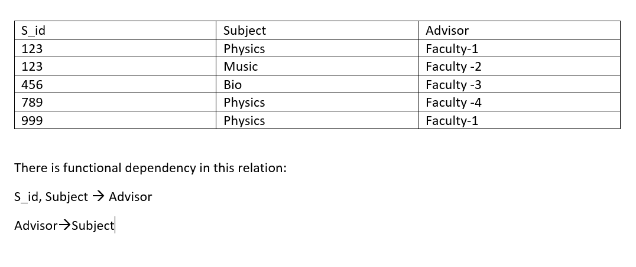
Example:
Here, S_id and Subject is the super key but Advisor is not the super key or Advisor is non prime attribute. Hence, it violates BCNF rule. This table is not in BCNF

Slide 72

Here in table student advisor S_id can be primary key and advisor can be foreign key and in advisor subject table advisor can be primary key.
Hence this tables are in BCNF.

Slide 73
4NF
The Fourth Normal Form (4NF) is an advanced level in the normalization process, aiming to handle certain types of anomalies which aren't addressed by the Third Normal Form (3NF). Specifically, 4NF addresses multi-valued dependencies.
A relation is in 4NF if:
1. It is already in 3NF.
2. No multi-valued dependencies exist. A multi-valued dependency occurs when an attribute depends on another attribute but not on the primary key.
To clarify, consider a relation R with attributes X, Y, and Z. We say that there is a multi-valued dependency from X to Y, denoted (X ->> Y), if for a single value of X, there are multiple values of Y associated with it, independent of Z.

Slide 74
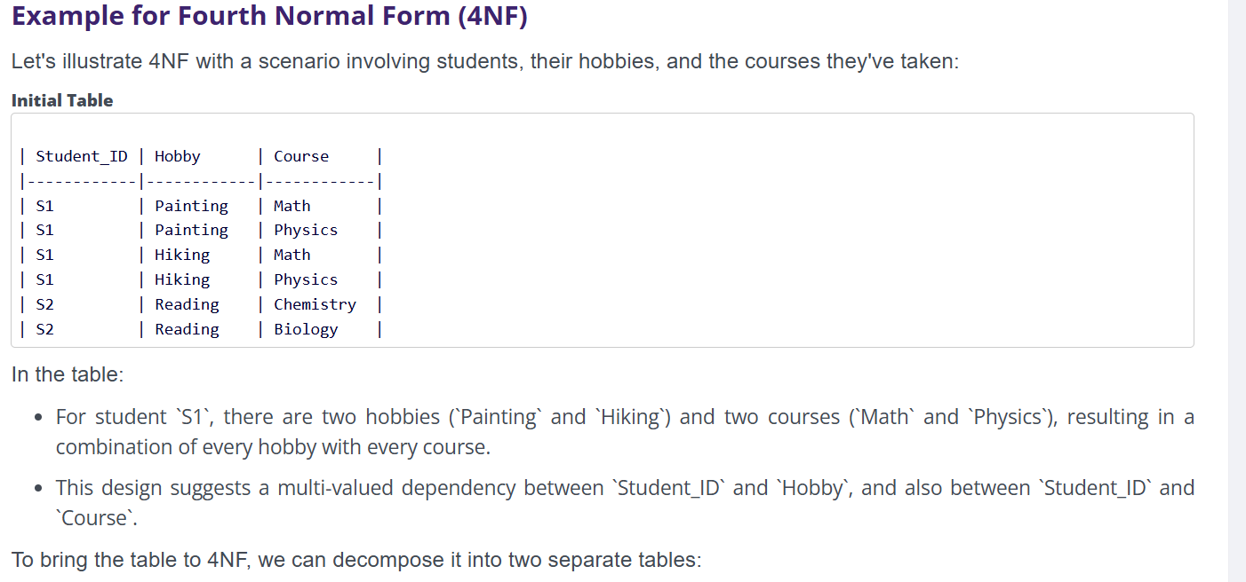
4NF

Slide 75

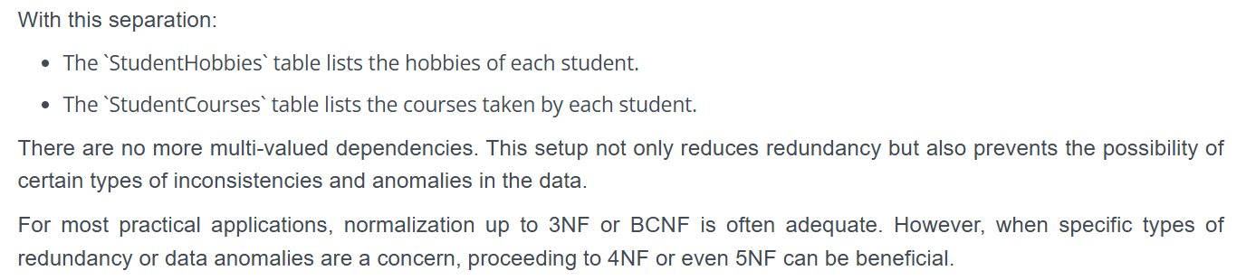
4NF

